Slide 1
Double Descent
Alexey Voskoboinikov

Slide 2
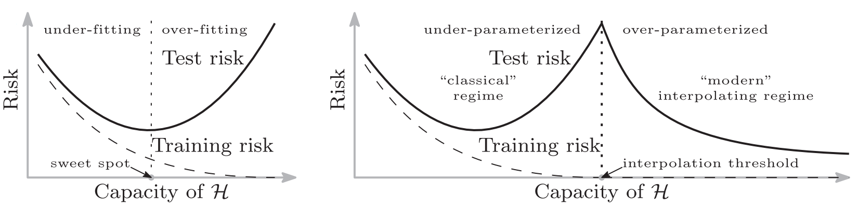
Double Descent
Classical generalization curve
Modern generalization curve
Belkin, Mikhail, et al. "Reconciling modern machine-learning practice and the classical bias–variance trade-off." Proceedings of the National Academy of Sciences 116.32 (2019): 15849-15854.

Slide 3
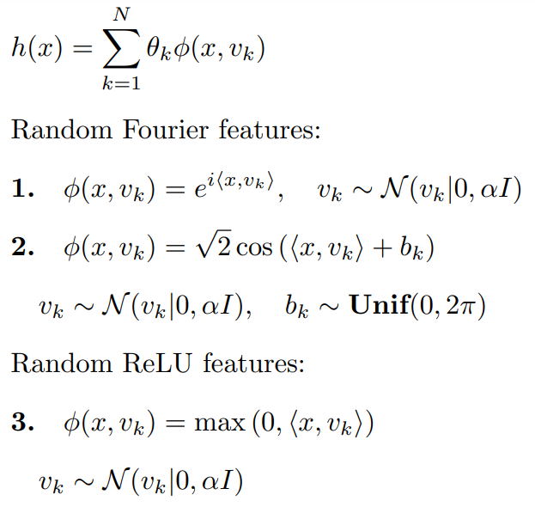
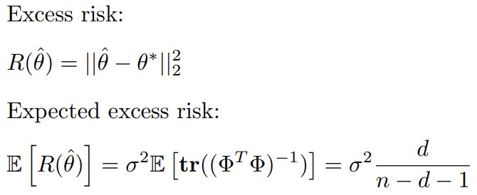
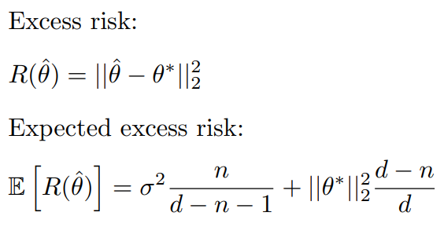
Linear model
Underparameterized regime
Overparameterized regime
Belkin, Mikhail, et al. "Reconciling modern machine-learning practice and the classical bias–variance trade-off." Proceedings of the National Academy of Sciences 116.32 (2019): 15849-15854.

Slide 4
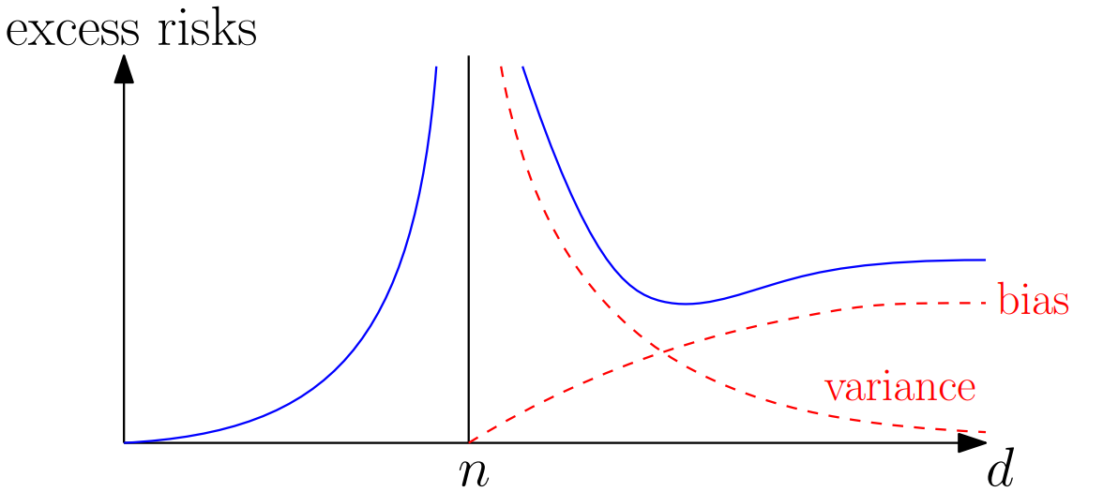
Linear model
Underparameterized regime
Overparameterized regime
Belkin, Mikhail, et al. "Reconciling modern machine-learning practice and the classical bias–variance trade-off." Proceedings of the National Academy of Sciences 116.32 (2019): 15849-15854.

Slide 5
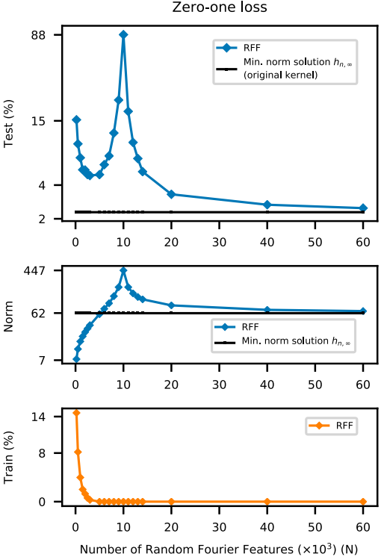
Linear model
Underparameterized regime
Overparameterized regime
Belkin, Mikhail, et al. "Reconciling modern machine-learning practice and the classical bias–variance trade-off." Proceedings of the National Academy of Sciences 116.32 (2019): 15849-15854.

Slide 6
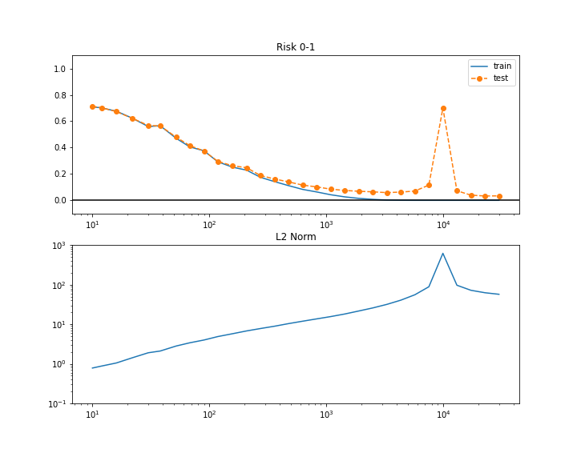
Linear model
Belkin, Mikhail, et al. "Reconciling modern machine-learning practice and the classical bias–variance trade-off." Proceedings of the National Academy of Sciences 116.32 (2019): 15849-15854.

Slide 7
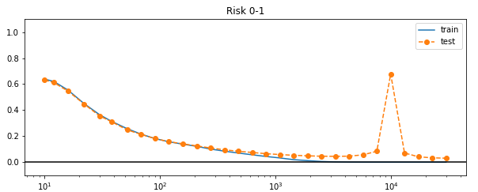
Linear model
Random Fourier features
Random Relu features
Belkin, Mikhail, et al. "Reconciling modern machine-learning practice and the classical bias–variance trade-off." Proceedings of the National Academy of Sciences 116.32 (2019): 15849-15854.

Slide 8
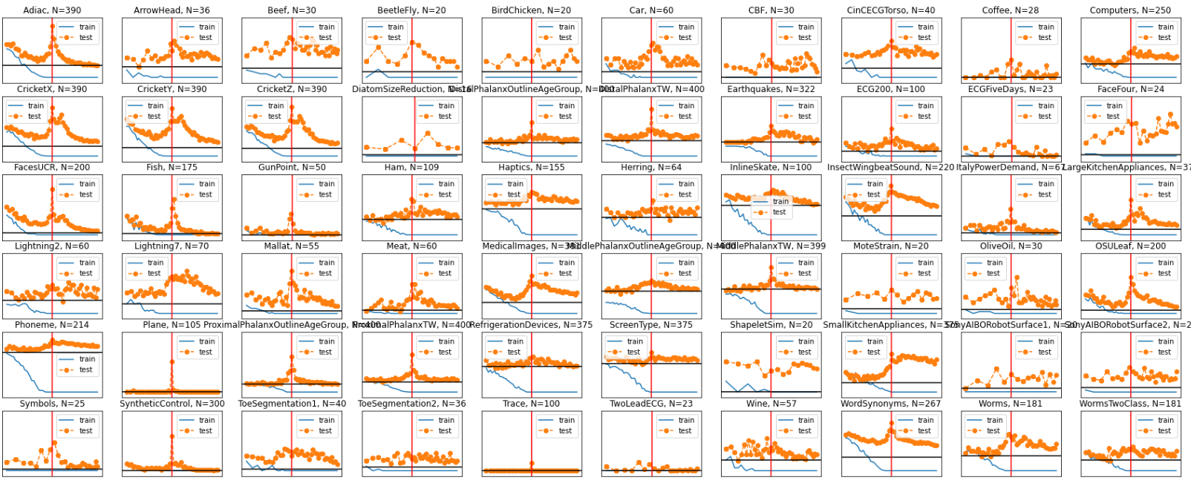
Rocket

Slide 9
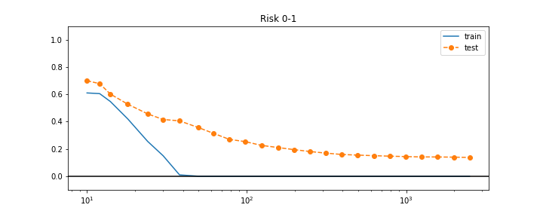
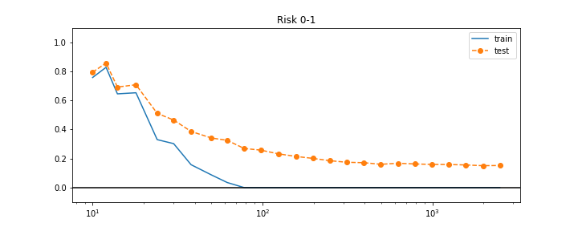
Different models
Logistic Regression
Linear SVM

Slide 10
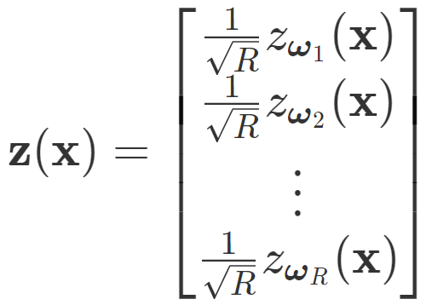
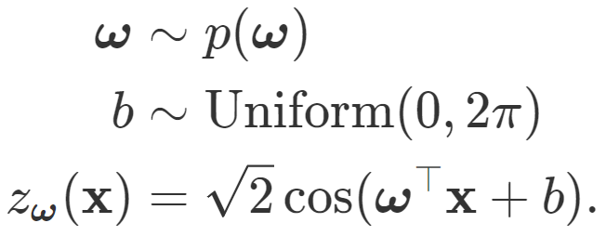
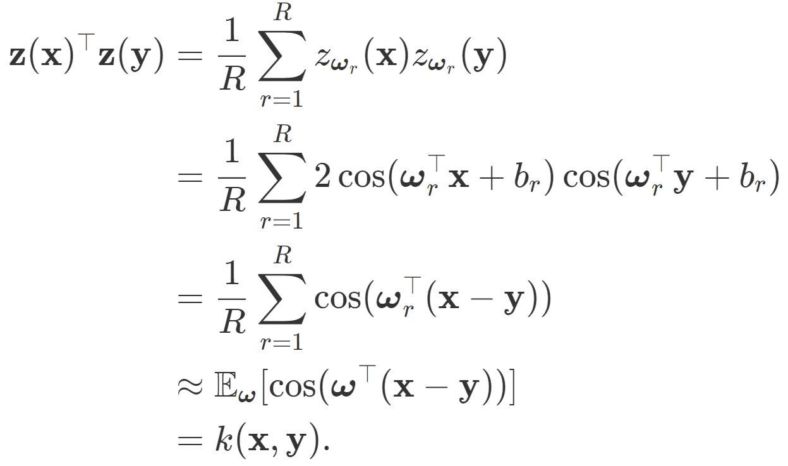
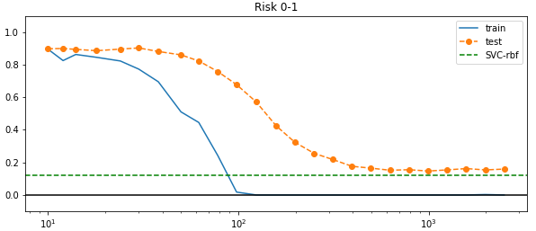
Linear SVM with RFF
Rahimi, Ali, and Benjamin Recht. "Random features for large-scale kernel machines." Advances in neural information processing systems 20 (2007).

